Slide 1

Relational Databases
Relational Algebra (II)
join, rename and notations
Originally Prepared by Jennifer Widom

Slide 2
Join Operations (Binary)
Various forms of join operation
Theta join
Equi join (a particular type of Theta join)
Natural join
Outer join

Slide 3
Relational Algebra (1)
Cross-product (X): combine two relations
(Cartesian product)
Names and GPAs of students with HS>1000 who applied to CS
and were rejected
∏_{sName,GPA} ( σ Student.sID=Apply.sID ^ HS>1000 ^ major=‘CS’ ^ _{dec=‘No’} (Students x Apply))
University
Student
Apply
uName | city | enr
sID | sName | GPA | HS
sID | uName | major | dec
Notes:
And let's see a big example of that. Let's suppose that we want to get the names and GPAs of students with a high school size greater than a thousand who applied to CS and were rejected. Okay, so let's take a look. We're going to have to access the students and the apply records in order to run this query. So what we'll do is we'll take student cross apply as our starting point. So now we have a big relation that contains eight attributes and all of those tuples that we described previously. But now we're going to start making things more interesting, because what we're going to do is a big selection over this relation. And that selection is first of all going to make sure that it only combines student and apply tuples that are referring to the same student. So to do that, we write student dot SID equals apply dot SID. So now we've filtered the result of that cross-product to only include combinations of student and apply by couples that make sets. Now we have to do a little bit of additional filtering. We said that we want the high school size to be greater than a thousand, so we do an "and" operator in the high school. We want them to have applied to CS so that's and major equals CS. We're getting a nice big query here. And finally we want them to have been rejected, so "and decision" equals, we'll just be using No for reject. So now, we've got that gigantic query. But that gets us exactly what we want except for one more thing, which is, as I said, all we want is their names and GPAs. So finally we take a big parentheses around here and we apply to that the projection operator, getting the student name and the GPA. And that is the relational algebra expression that produces the query that we have written in English.

Slide 4
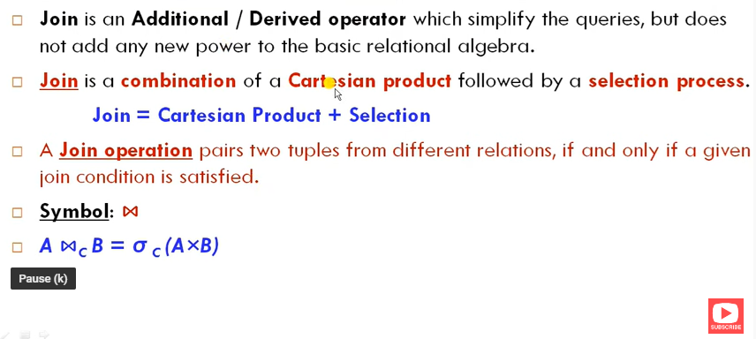
Join

Slide 5
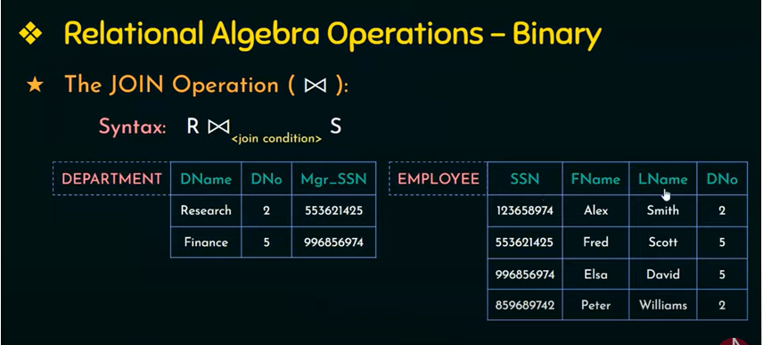

Slide 6
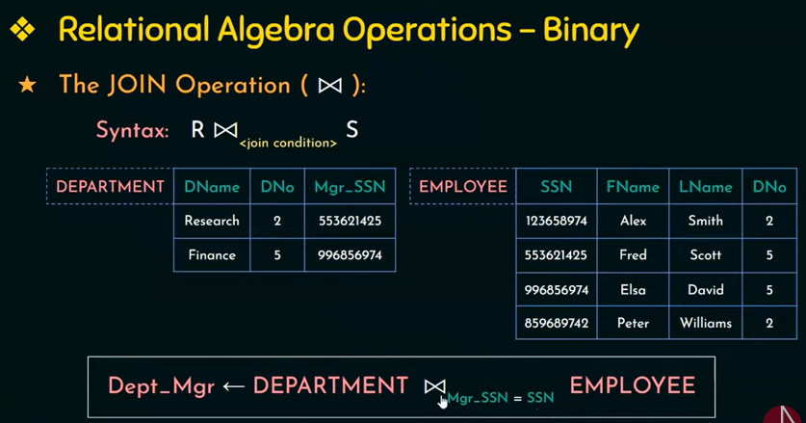

Slide 7
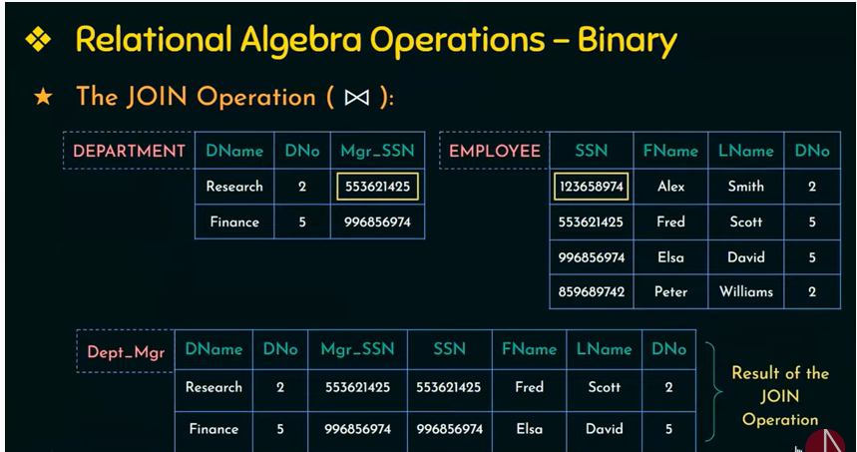

Slide 8
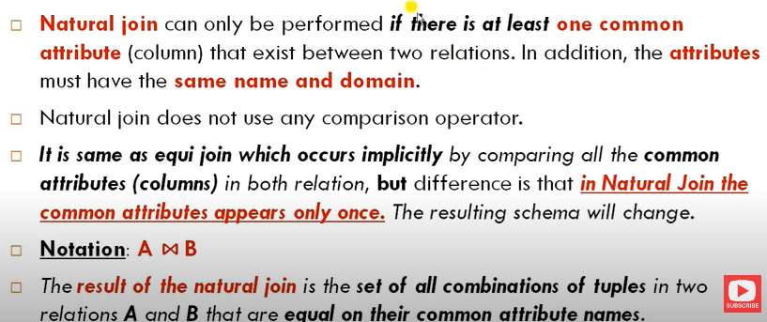
Natural join

Slide 9
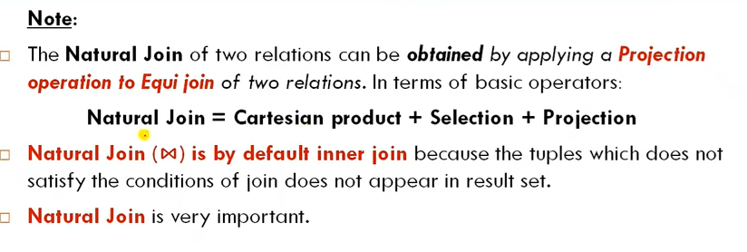
Natural join

Slide 10
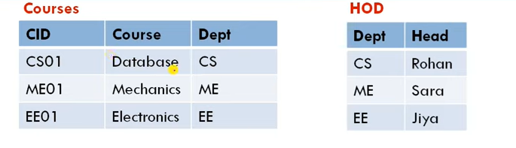
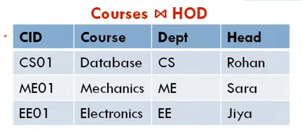
Natural join example

Slide 11
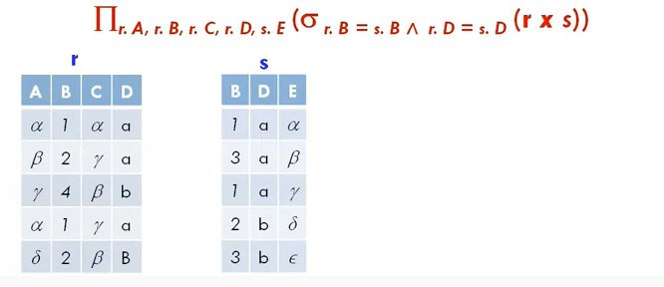
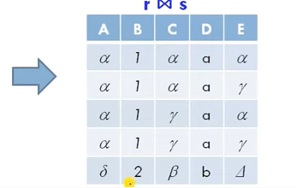
Natural join

Slide 12
Natural join

Slide 13
Relational Algebra (1)
Natural Join (⋈)
Eliminate one copy of duplicate attributes
⋈ =
Student
Apply
sID | sName | GPA | HS | uName | major | dec
1 | Ahmed | 3.4 | 1200 | Comsats | CS | No
1 | Ahmed | 3.4 | 1200 | Comsats | EE | Yes
2 | Ali | 3.75 | 2000 | NUST | CS | No
sID | sName | GPA | HS
1 | Ahmed | 3.4 | 1200
2 | Ali | 3.75 | 2000
sID | uName | major | dec
1 | Comsats | CS | No
1 | Comsats | EE | Yes
2 | NUST | CS | No
Notes:
Now we have seen how the cross product allows us to combine tuples and then apply selection conditions to get meaningful combinations of tuples. It turns out that relational algebra includes an operator called the natural join that is used pretty much for the exact purpose. What the natural join does is it performs a cross-product but then it enforces equality on all of the attributes with the same name. So if we set up our schema properly, for example, we have sID in Student relation and sID in Apply relation, meaning the same thing, and when the cross product is created, it's only going to combine tuples where the student ID is the same Now in addition, one more thing that it does is it gets rid of these pesky attributes that have the same names. So since when we combine, for example, student and apply with the natural join, we're only combining tuples where the student SID is the same as the apply SID. Then we don't need to keep two copies of that column because the values are always going to be equal. So the natural join operator is written using a bow tie, that's just the convention.

Slide 14
Natural join
R S
An Equijoin of the two relations R and S over all common attributes x. One occurrence of each common attribute is eliminated from the result.

Slide 15
Relational Algebra (1)
Natural Join (⋈)
Names and GPAs of students with HS>1000 who applied to CS
and were rejected
Names and GPAs of students with HS>1000 who applied to CS
at University with enr>20,000 and were rejected
∏_{sName,GPA} ( σ _{enr>20000} _{^ HS>1000 ^ major=‘CS’ ^} _{dec=‘No’} (Students ⋈ Apply ⋈ University) )
University
Student
Apply
uName | city | enr
sID | sName | GPA | HS
sID | uName | major | dec
Notes:
Now let's add one more complication to our query. Let's suppose that we're only interested in applications to Universities where the enrollment is greater than 20,000. So far in our expression we refer to the student relation and the apply relation, but we haven't used the University relation. But if we want to have a filter on enrollment, we're going to have to bring the University relation into the picture. This turns out to perhaps be easier than you think. What we're going to do is we're going to join in the University relation, with the two relations we have already. Now, technically, the natural join is the binary operator, people often use it without parentheses because it's associative, but if we get pedantic about it we could add that and then we're in good shape. Now we've joined all three relations together. And remember, automatically the natural join enforces equality on the shared attributes. Very specifically, the University name here is going to be set equal to the apply University name as well. Now once we've done that, we've got all the information we need. We just need to add one more filtering condition, which is that the University enrollment is greater than 20,000. And with that, we've solved our query. So to summarize the natural join, the natural join combines relations. It automatically sets values equal when attribute names are the same and then it removes the duplicate columns.

Slide 16
Relational Algebra (1)
Theta Join (⋈_{θ})
Basic operation implemented in DBMS
Term “join” often means theta join
Does not add expressive power
R1⋈_{θ} R2 = ( σ_{θ} (R1 xR2) )
University
Student
Apply
uName | city | enr
sID | sName | GPA | HS
sID | uName | major | dec
Notes:
The last operator that I'm going to cover is the theta join operator. Like natural join, theta join is actually an abbreviation that doesn't add expressive power to the language. Let me just write it. The theta join operator takes two relations and combines them with the bow tie looking operator, but with a subscript theta. That theta is a condition. It's a condition in the style of the condition in the selection operator. And what this actually says - it's pretty simple - is it's equivalent to applying the theta condition to the cross-product of the two expressions. So you might wonder why I even mention the theta join operator, and the reason I mention it is that most database management systems implement the theta join as their basic operation for combining relations. So the basic operation is take two relations, combine all tuples, but then only keep the combinations that pass the theta condition. Often when you talk to people who build database systems or use databases, when they use the word join, they really mean the theta join.

Slide 17
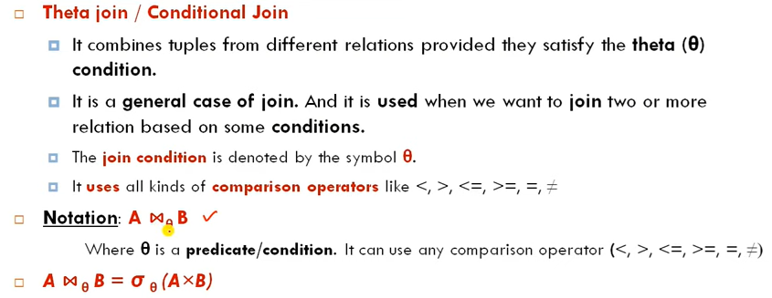

Slide 18
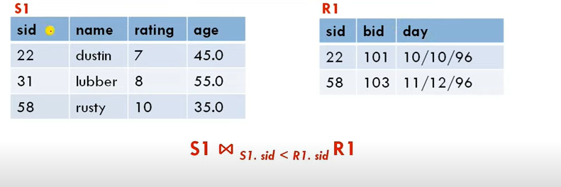
Theta join

Slide 19
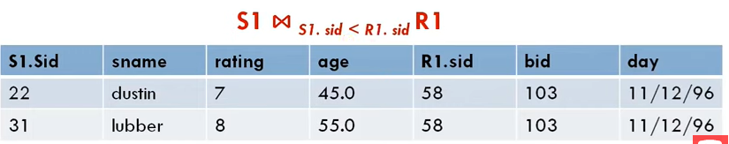

Theta join (resulting relation)

Slide 20
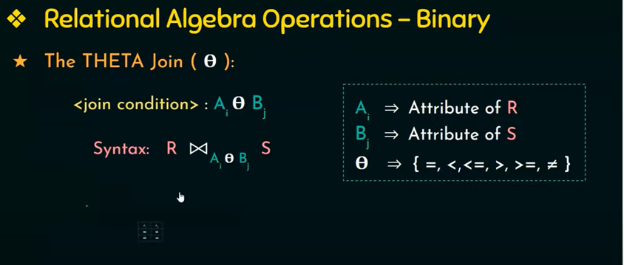

Slide 21
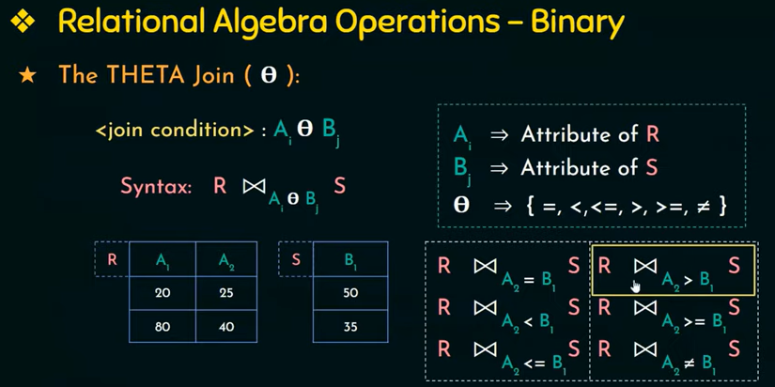

Slide 22
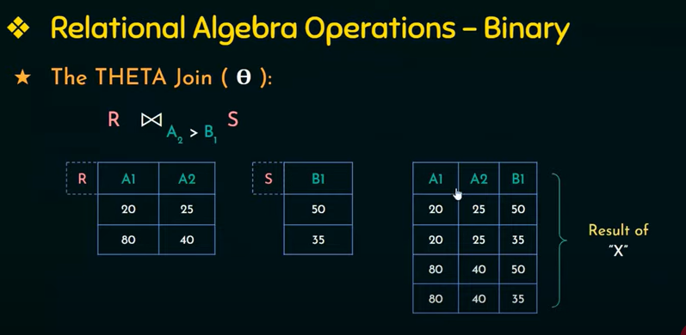

Slide 23
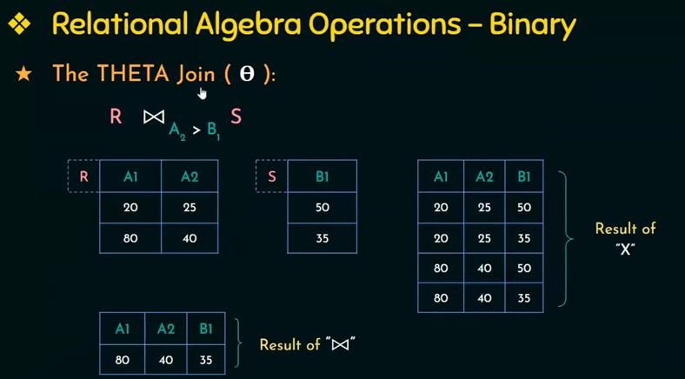

Slide 24
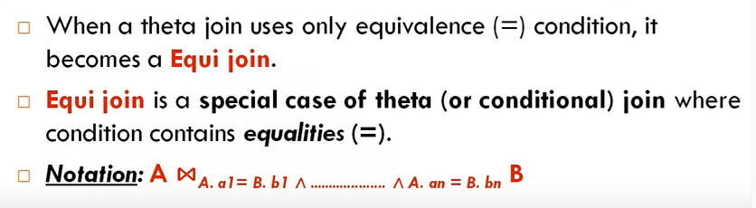
Equi join

Slide 25
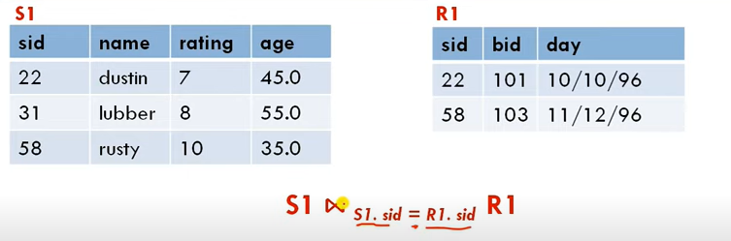
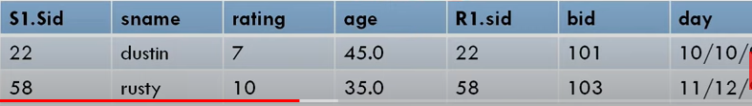

Equi join

Slide 26
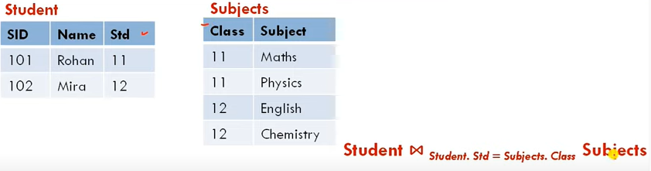
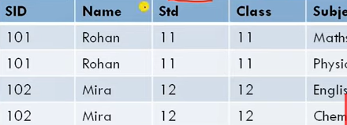
Equi join

Slide 27
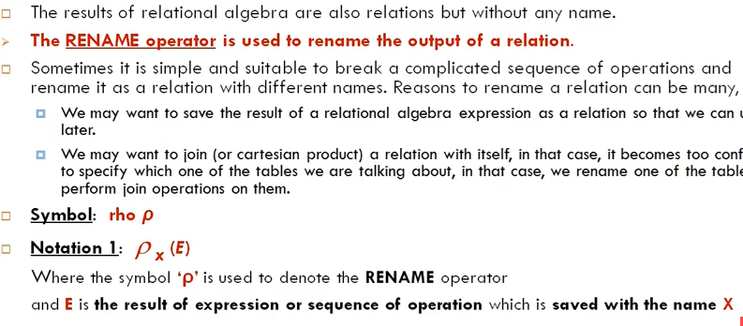
Rename operator (unary )

Slide 28
Relational Algebra (2)
Rename operator (ρ)
1. ρ_{R(A1,A2,A3,… An)} (E) Renames both the relation and attributes names
2. ρ_{R} (E) Renames just the relation name
3. ρ_{(A1,A2,A3,…An)} (E) Renames just the attributes names
University
Student
Apply
uName | city | enr
sID | sName | GPA | HS
sID | uName | major | dec
Notes:
Our last operator is the rename operator. The rename operator is necessary to express certain queries in relational algebra. Let me first show the form of the operator and then we'll see it in use. The rename operator uses the Greek symbol rho.
1- Rename relation E to R and E’s attributes to A1,A2,A3,… An.
2- Rename relation E to R. Does not change the attributes name.
3- Rename E’s attributes to A1,A2,A3,… An. Does not change the relation name.

Slide 29
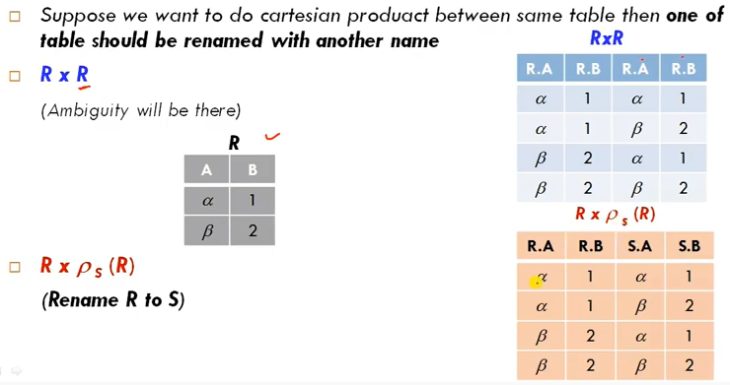
Rename table name

Slide 30
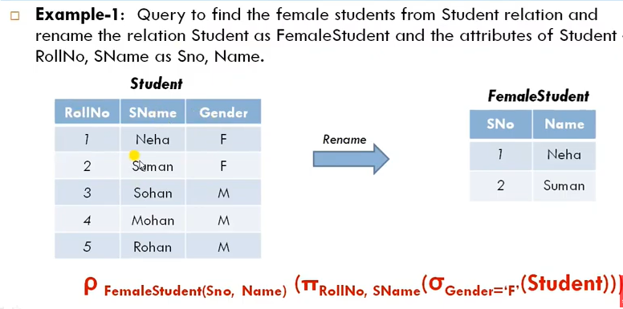

Slide 31
Relational Algebra (2)
Rename operator
For disambiguation in “self-joins”
Pairs of universities in same city
σ _{city=city} (University x University)
∏_{n1,n2} (σ _{c1=c2 ^ n1<n2} (ρ_{U1(n1,c1,e1)}University x ρ_{U2(n2,c2,e2)}University) )
University
Student
Apply
uName | city | enr
sID | sName | GPA | HS
sID | uName | major | dec
Notes:
Now, the second use of the rename operator is a little more complicated and quite a bit more important actually which is disambiguation in self joins and you probably have no idea what I'm talking about when I say that, but let me give an example.
Let's suppose that we wanted to have a query that finds pairs of universities in the same city. Now, think about that. So we want to have, for example, (Comsats , FAST) and (FAST, NUST) and so on. So that, as you can see, unlike the union operator, we're looking for this horizontal joining here. So we're going to have to combine essentially two instances of the university relation. And that's exactly what we're going to do. We're effectively going to do university join university making the city equal. So, let's work on that a little bit. So, what we wanna do is we wanna have university and we want to, let's just start with, say, the cross-product of university. And then we want to somehow say, "Well, the city equals the city." But that's not gonna work. Which city are these? And how do we describe the two instances of universities? So what we're going to do is we're going to rename those two instances of universities so they have different names. So we're going to take the first instance of university here and we're going to apply a rename operator to that. And we'll call it U1 and we'll say that that has n1, c1, and e1. And then we'll take the second instance here. We'll call it U2, so attribute are renamed to n2, c2, e2 and now we have two different relations. So what we can do is we can take the cross-product of those two like that, and then we can select where c1 equals c2, okay? And that gives us pairs of universities in the same city. One problem with this query is that we are going to get universities paired with themselves. So we're going to get from this, for example, (Comsats, Comsats). Also (Comsats, FAST), as well as (FAST, Comsats) which is redundant. Now, that's not really what we want presumably. Presumably we actually want different universities. but that's pretty easy to handle, actually. Let's put a selection condition here so that the name one is less than to name two. And now we'll only get pairs where the first one is less than the second. So (FAST, Comsats) goes away and we get (Comsats, FAST). And this is our final query for what we wanted to do here. Now what I really wanted to show, aside from some of the uses of relational algebra, is the fact that the rename operator was for this query absolutely necessary. We could not have done this query without the rename operator.

Slide 32
Relational Algebra (2)
Rename operator
For disambiguation in “self-joins”
Pairs of universities in same city
∏_{n1,n2} (σ _{n1<n2} (ρ_{U1(n1,c,e1)}University ⋈ ρ_{U2(n2,c,e2)}University) )
University
Student
Apply
uName | city | enr
sID | sName | GPA | HS
sID | uName | major | dec
Notes:
Actually, let me show you an even trickier, simpler way of doing this. Let's take away the cross product here. And let's make this into a natural join and make attribute names, c1 and c2, to be the same i.e. c. And now when we do the natural join, it's gonna require equality on those two c's and everything is gonna be great.

Slide 33
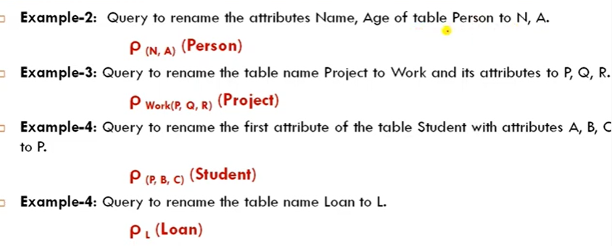
Rename examples

Slide 34
Relational Algebra (2)
Alternate notation (1)
Assignment statements (:=)
Pairs of universities in same city
A1 := ρ_{U1(n1,c,e1)}University
A2 := ρ_{U2(n2,c,e2)}University
A3 := A1⋈ A2
A4 : = σ _{n1<n2} (A3)
Ans : =∏_{n1,n2} (A4)
Notes:
Now we've seen all the operators of relational algebra. Before we wrap up I did want to mention that there are some other notations that can be used for relational algebra expressions.
Assignment statements are a way to break down relational algebra expressions into their parts.
Let's do the same query we just finished as a big expression which is the pairs of universities that are on the same city. This is equivalent to the expression that we saw on the earlier slide. It's just a notation that sometimes people prefer to modularize their expressions.

Slide 35
Relational Algebra (2)
Alternate notation (2)
Expression tree – GPAs of students applying to CS in Islamabad
∏_{GPA} ( σ _{city=‘ISB’ ^ major=‘CS’} (Students ⋈ Apply ⋈ University) )
∏_{GPA}
σ _{city=‘ISB’ ^ major=‘CS’}
⋈
⋈
Student
Apply
University
sID | sName | GPA | HS
sID | uName | major | dec
uName | city | enr
Notes:
The second alternate notation I'm going to show is expression trees. And expression trees are actually commonly used in relational algebra. They allow you to visualize the structure of the expression a little bit better. And as it turns out when SQL is compiled in database systems, it's often compiled into an expression tree that looks very much like what I'm gonna show you right now. So for this example let's suppose that we want to find the GPAs of students who are applying to CS in Islamabad. So that's going to involve all three relations because we're looking at the city, and we're looking at the student GPA's and we're looking at them applying to CS. So what we're going to do is we're going to make a little tree notation here where we're going to first do the natural join of these three relations. So the leaves of the expression are going to be the three relations: university, students, and apply. And in relational algebra trees, the leaves are always relation names. The selection condition that says that the city equals Islamabad and the major equals CS. And finally, we'll put on top of that the projection that gets the GPA. Now actually this expression is exactly equivalent to if we wrote it linearly, project the GPA, select etc. of the three university join student, join apply. That would be an equivalent expression.
But again, people often like to use the tree notation because it does allow you to visualize the structure of the expression, and it is used inside implementations of the SQL language.

Slide 36
Relational Algebra (2)
Relational Algebra summary
Core
R
σ_{condition} R
∏_{A1,A2,A3,…An} R
R1 x R2
R1 U R2
R1 - R2
ρ_{R(A1,A2,A3,… An)} (E)
Derived/Abbreviated
R1 ⋈ R2
R1 ⋈_{θ} R2
R1 ∩ R2
Notes:
Let me finish up by summarizing relational algebra. Let's start with the core constructs of the language. So a relation name is a query in relational algebra, and then we use operators that combine relations and filter relations. So we have the select operator that applies a condition to the result of an expression. We have the project operator that gives us a set of attributes that we take from the result of an expression. We have the relation one cross-product relation two. Then we have relation one union relation two. And we have relation one minus relation two. And finally we have the rename operator.
Now, you probably noticed that I skipped a few of our favorite operators, but this is the core of the language and all the other operators are actually abbreviations that don't increase the expressive power of the language but they can be very useful performing queries. And the abbreviations that we learned were relation one natural join relation two. They were relation one theta join relation two. And, finally, relation one intersect relation two. All of those where we had a method of rewriting them using the core operators.
Just a small aside about parentheses. A parentheses are used in relational expressions for, relational algebraic expressions, for disambiguation, similarly to arithmetic expressions. I was a little cavalier about whether I included parentheses or not, but as you write your relational algebra expressions you will see that it's pretty straightforward to figure out when disambiguation is needed.
So to conclude relational algebra, entirely it's a formal language. It's based on sets, set operators and other operators that combine data from multiple relations. It takes relations as input, it produces relations as answers and it does form the formal foundation of implemented relational database management.

Slide 37
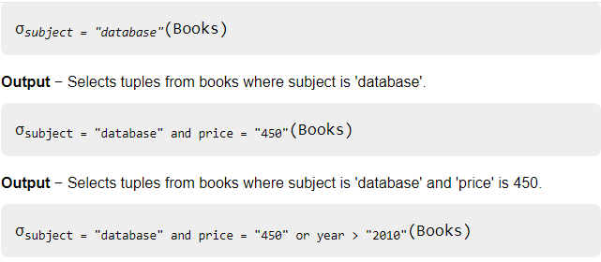
Quiz from previous lecture

